Slide 1
CAMPUSCONNECT : A COMPREHENSIVE STUDENT MANAGEMENT SYSTEM
By
S. SURIYAPRATHAP
(111923MC02053)
GUIDE : MRS. R. RAJESHWARI, MCA., MPHIL(PH.D)

Slide 2
ABSTRACT
CampusConnect: A Comprehensive College Management System is an integrated platform designed to streamline academic and administrative processes within educational institutions.
It provides a structured and interactive system for students, faculty, and administrators, ensuring efficient management of essential academic activities.
The system centralizes student registration, course management, enrollment, attendance tracking, assignment submission, grading, and report generation into a single platform.
The system enhances overall efficiency by eliminating manual paperwork and reducing administrative workload.

Slide 3
INTRODUCTION
Educational institutions handle large volumes of data daily, including: Student records, Course enrollments, Attendance, Grading, Faculty & admin operations.
Traditional/manual systems lead to: Inefficiencies, Redundant data, Increased workload and Error-prone processes.
CampusConnect is a centralized platform to:
Automate academic and administrative tasks
Streamline student enrollment, attendance, assignments, grading, and reports
Provide role-based access for Students, Faculty, and Admins

Slide 4
FEATURES
All-in-One Academic Hub – Manages registration, attendance, grades, and reports.
Role-Based Access – Separate panels for students, faculty, and admins.
Real-Time Updates – Instant access to academic data and alerts.
Secure & Scalable – Encrypted data, secure login, and easy to expand.

Slide 5
Existing system
Most institutions still rely on manual processes or outdated
digital tools.
Data is often managed using:
Paper-based records
Excel spreadsheets
Disconnected software systems
Lack of integration leads to inefficiencies and
communication gaps.
Academic and administrative tasks are performed in silos,
with minimal automation.

Slide 6
DISADVANTAGES OF EXISTING SYSTEM
Time-Consuming Processes
Data Redundancy & Inconsistency
Limited Accessibility
Lack of System Integration
Manual Attendance Management
Delayed Grading & Feedback
Security Concerns

Slide 7
proposed system
CampusConnect is a centralized and fully automated college management system.
It integrates academic and administrative operations into a single platform.
Designed for role-based access for Admin, Faculty, and Students.
Focuses on improving:
Efficiency
Data accuracy
User accessibility
Security and transparency

Slide 8
ADVANTAGES OF proposed SYSTEM
Secure Authentication & Role-Based Access
Control (RBAC)
Digital Attendance Management
Assignment Submission & Automated Grading
Centralized Academic Record System
Data Security & Encryption
Real-Time Information Access

Slide 9
System requirements
HARDWARE REQUIREMENTS
Component | Specification
Processor | Intel Core i5/i7 (or equivalent)
RAM | 8GB or higher
Storage | 50GB SSD or higher
Peripherals | Keyboard, Mouse, and Monitor
Internet | Stable high-speed connection

Slide 10
System requirements
SOFTWARE REQUIREMENTS
Software | Version | Software | Version
Operating System | Windows10/ macOS/Linux | Material UI / Tailwind CSS | Latest
Node.js | 18.x or later | JWT (JSON Web Tokens) | Latest
Express.js | 4.x | VS Code / Any IDE | Latest
MongoDB | 6.x or later | Nodemon | Latest
React.js | 18.x or later | Mongoose | Latest

Slide 11
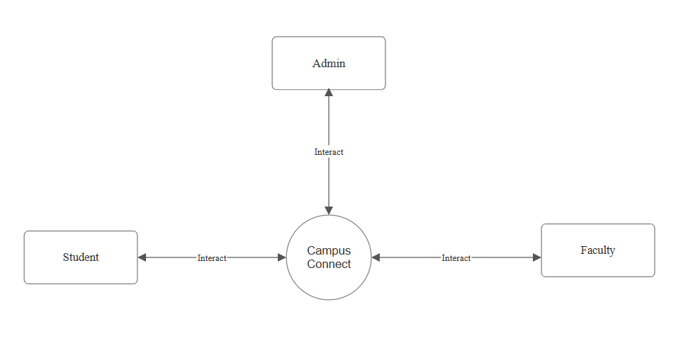
DATAFLOW DIAGRAM
DFD LEVEL 0

Slide 12
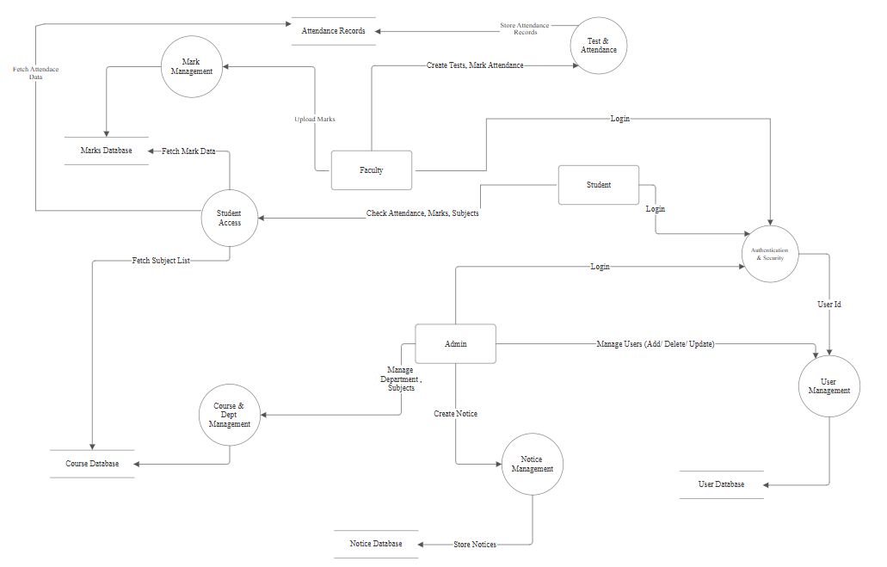
DATAFLOW DIAGRAM
DFD LEVEL 1

Slide 13
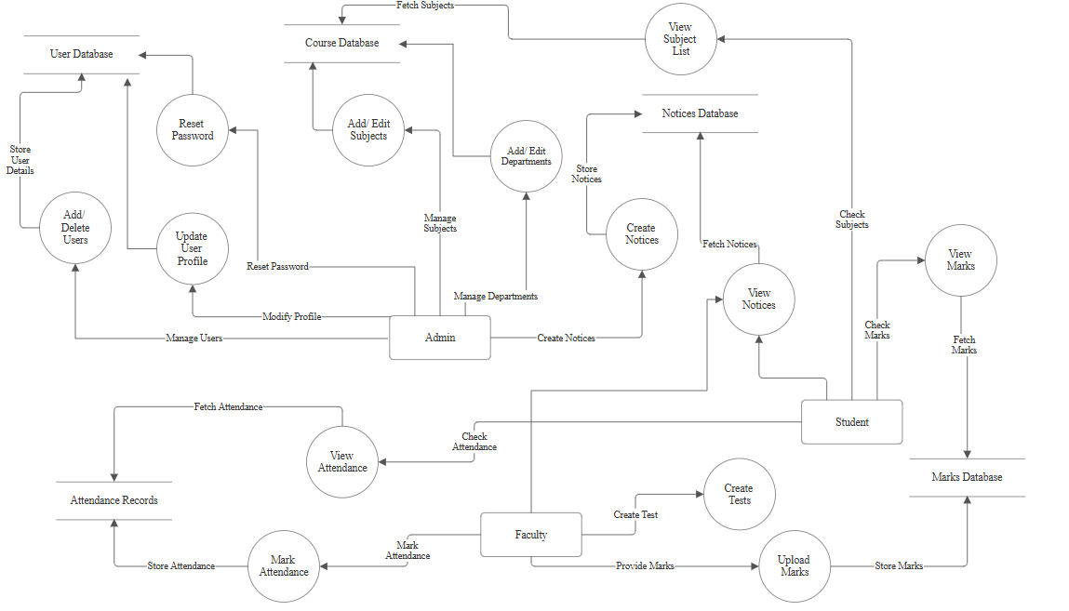
DATAFLOW DIAGRAM
DFD LEVEL 2

Slide 14
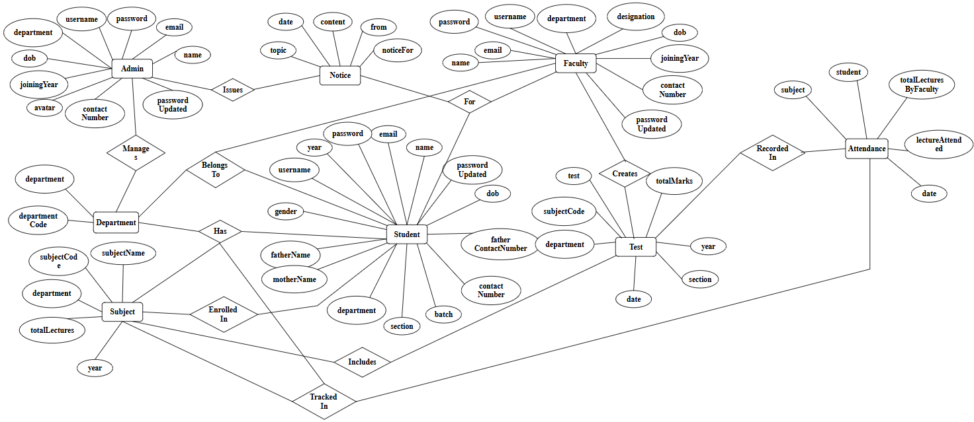
er DIAGRAM

Slide 15
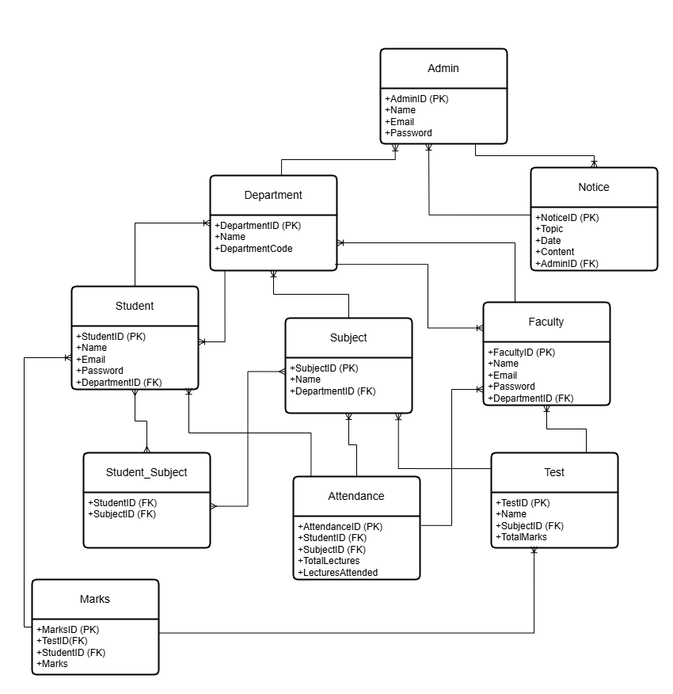
Table relationship

Slide 16
Data dictionary
ADMIN TABLE
ADMIN TABLE
Attribute Name | Data Type | Description | Constraints
name | String | Admin’s full name | Required
email | String | Admin’s unique email address | Required, Unique
password | String | Admin’s hashed password | Required
username | String | Unique username for login | Required
department | String | Admin’s assigned department | Optional
dob | String | Date of Birth | Optional
joiningYear | String | Year of joining | Optional
avatar | String | Profile picture URL | Optional
contactNumber | Number | Phone number | Optional
passwordUpdated | Boolean | Status of password update | Default: false

Slide 17
Data dictionary
ADMIN TABLE
FACULTY TABLE
Attribute Name | Data Type | Description | Constraints
name | String | Faculty member’s full name | Required
email | String | Faculty’s unique email | Required, Unique
password | String | Faculty’s hashed password | Required
username | String | Unique login username | Required
department | String | Department assigned | Required
designation | String | Role in the department | Required
dob | String | Date of Birth | Required
joiningYear | Number | Year faculty joined | Required
contactNumber | Number | Phone number | Optional
passwordUpdated | Boolean | Status of password update | Default: false

Slide 18
Data dictionary
ADMIN TABLE
STUDENT TABLE
Attribute Name | Data Type | Description | Constraints
name | String | Student’s full name | Required
email | String | Unique email | Required, Unique
password | String | Hashed password | Required
year | Number | Current academic year | Required
username | String | Unique username | Optional
gender | String | Gender | Optional
fatherName | String | Father’s name | Optional
motherName | String | Mother’s name | Optional
department | String | Assigned department | Required
section | String | Student’s section | Required
batch | String | Batch number | Optional
contactNumber | Number | Student’s phone number | Optional
fatherContactNumber | Number | Father’s phone number | Optional
dob | String | Date of Birth | Required
passwordUpdated | Boolean | Password update status | Default: false

Slide 19
Data dictionary
ADMIN TABLE
DEPARTMENT TABLE
Attribute Name | Data Type | Description | Constraints
department | String | Name of the department | Required
departmentCode | String | Unique department code | Required, Unique

Slide 20
Data dictionary
ADMIN TABLE
SUBJECT TABLE
Attribute Name | Data Type | Description | Constraints
subjectName | String | Subject title | Required
subjectCode | String | Unique subject code | Required
department | String | Department offering the subject | Required
totalLectures | Number | Total lectures planned | Default: 10
year | String | Academic year | Required

Slide 21
Data dictionary
ADMIN TABLE
ATTENDANCE TABLE
Attribute Name | Data Type | Description | Constraints
student | ObjectId | Student ID (Foreign Key) | References Student
subject | ObjectId | Subject ID (Foreign Key) | References Subject
totalLecturesByFaculty | Number | Lectures conducted by faculty | Default: 0
lectureAttended | Number | Number of lectures attended | Default: 0
date | Date | Date of attendance update | Required

Slide 22
Data dictionary
ADMIN TABLE
TEST TABLE
Attribute Name | Data Type | Description | Constraints
test | String | Test name | Required
subjectCode | String | Subject code linked to the test | Required
department | String | Department offering the test | Required
totalMarks | Number | Maximum marks | Default: 10
year | String | Academic year | Required
section | String | Section appearing for the test | Required
date | String | Date of test | Required

Slide 23
Data dictionary
ADMIN TABLE
MARKS TABLE
Attribute Name | Data Type | Description | Constraints
exam | ObjectId | Test ID (Foreign Key) | References Test
student | ObjectId | Student ID (Foreign Key) | References Student
marks | Number | Marks obtained | Default: -1

Slide 24
Data dictionary
ADMIN TABLE
NOTICE TABLE
Attribute Name | Data Type | Description | Constraints
topic | String | Notice title | Required
date | String | Date of posting | Required
content | String | Notice details | Required
from | String | Sender (Admin or Faculty) | Required
noticeFor | String | Target audience (Faculty/Student) | Required

Slide 25
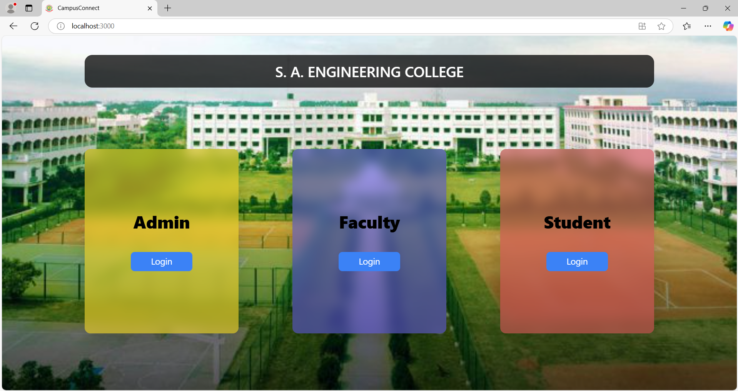
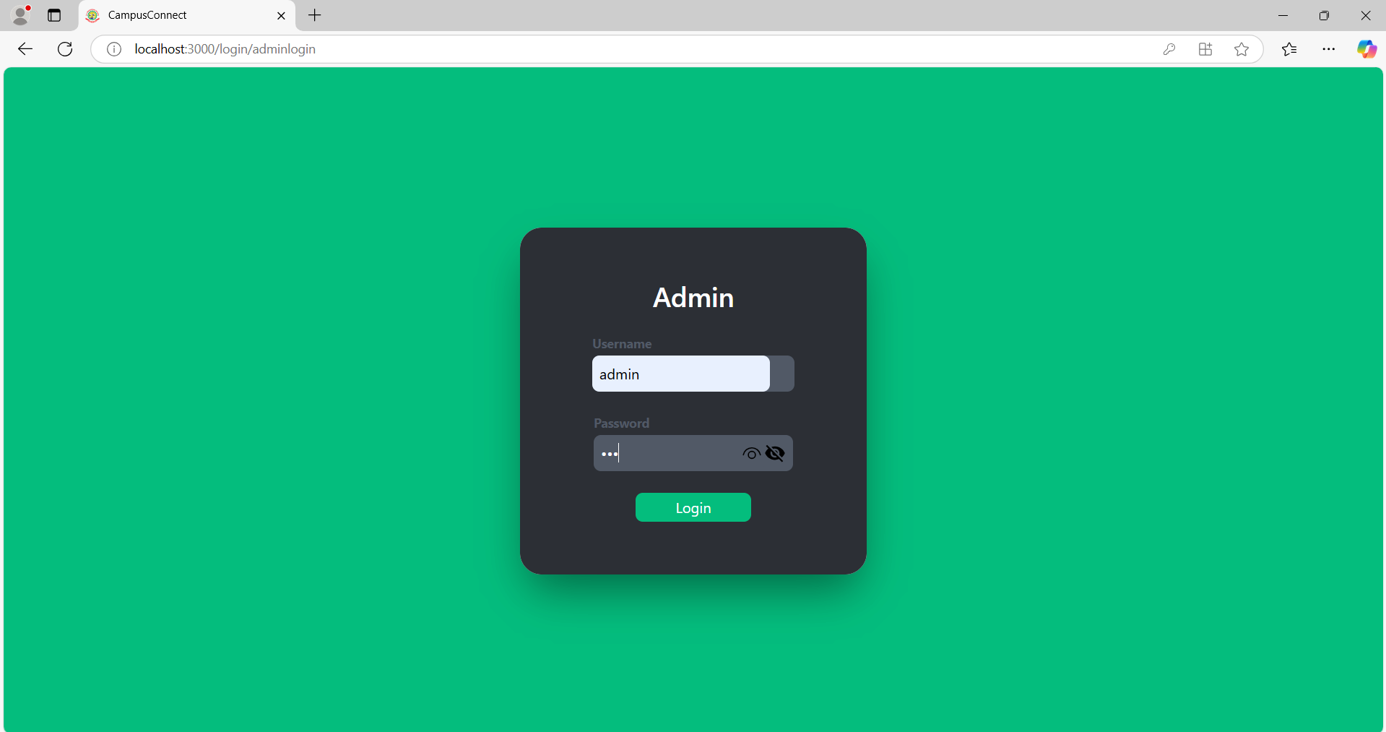
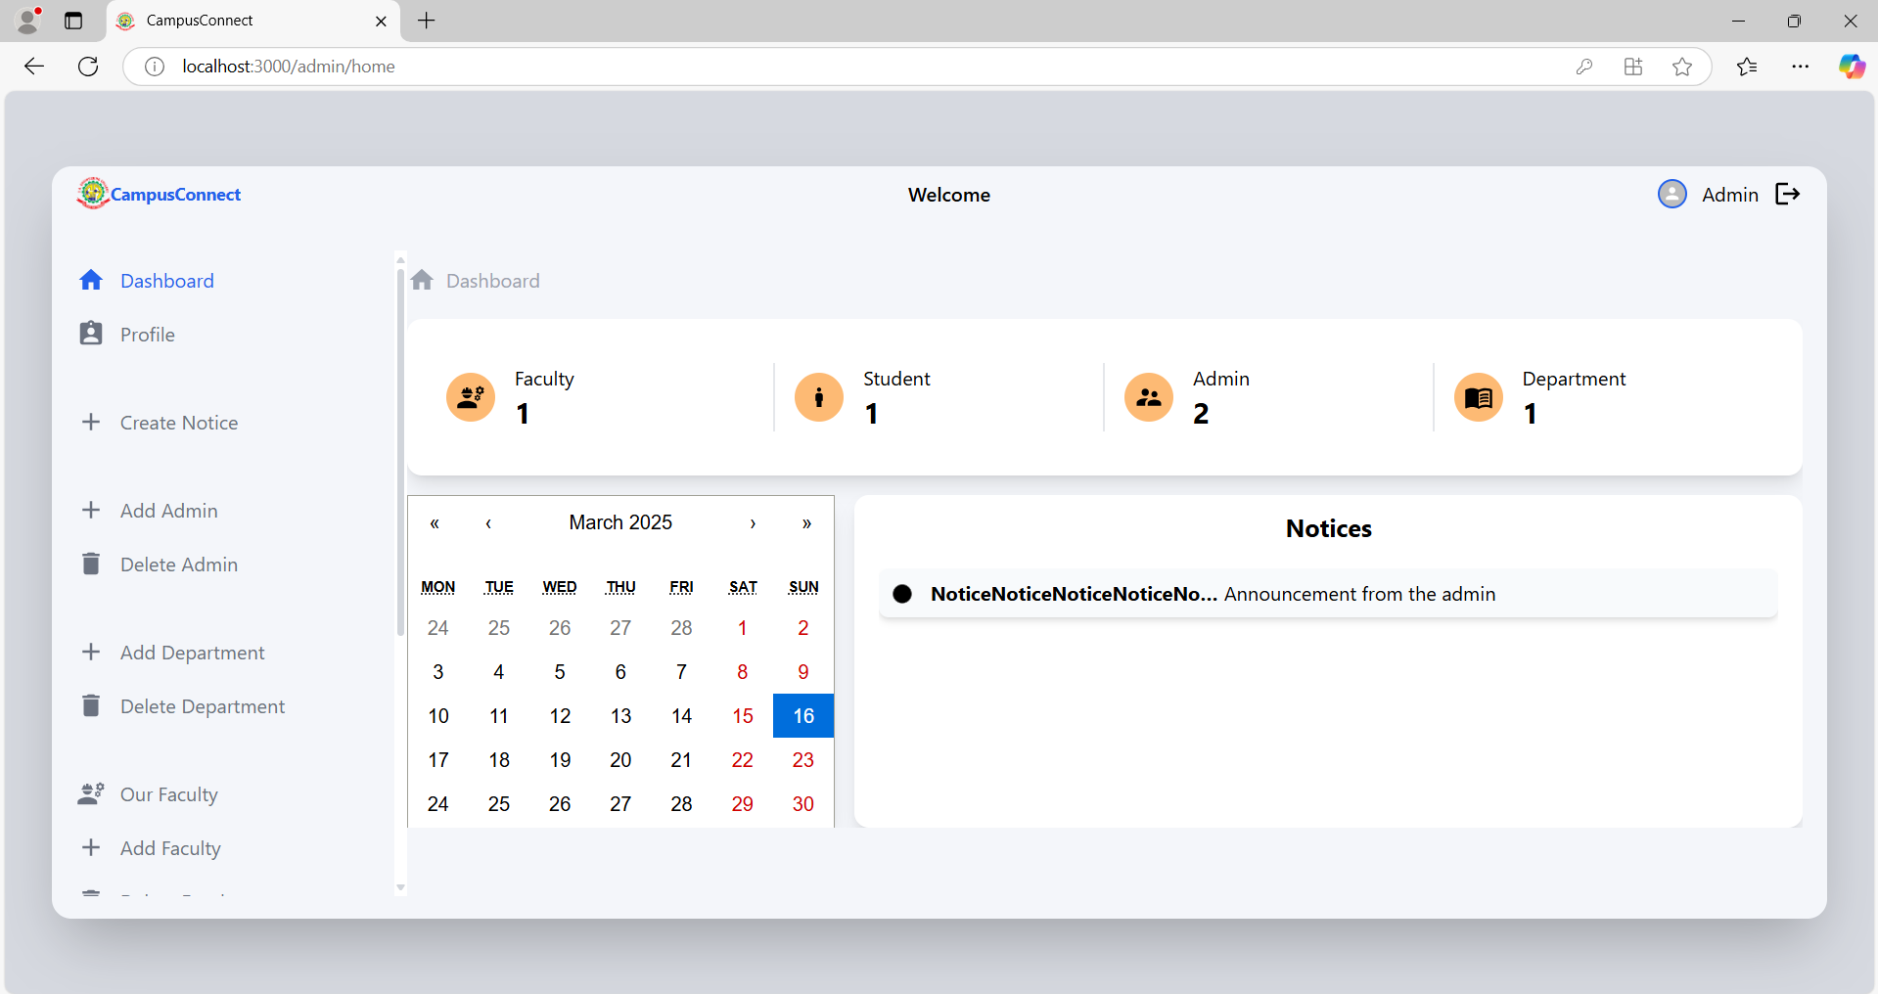
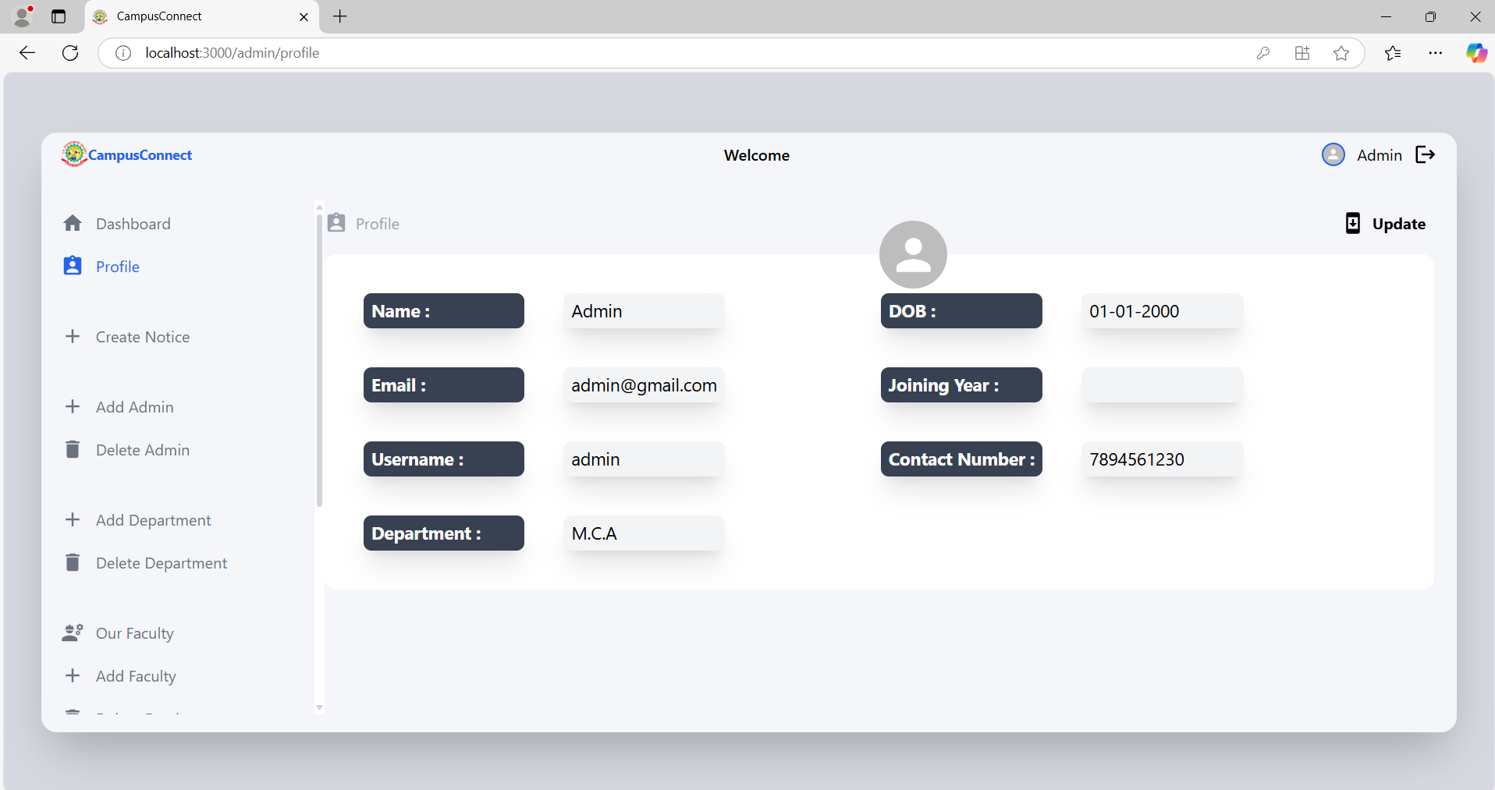
Sample screens

Slide 26
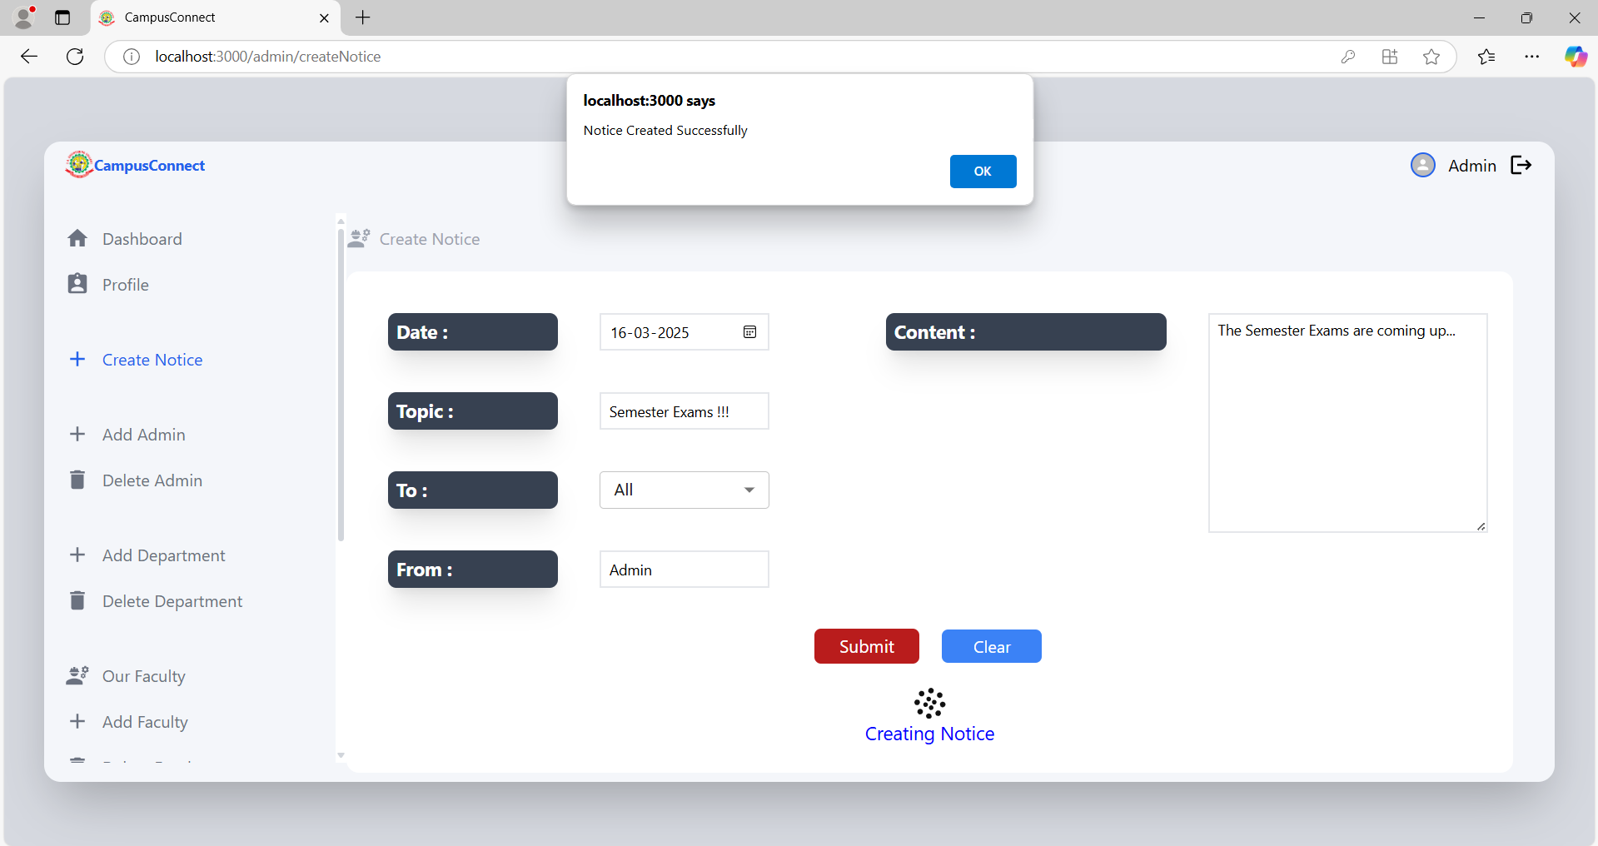
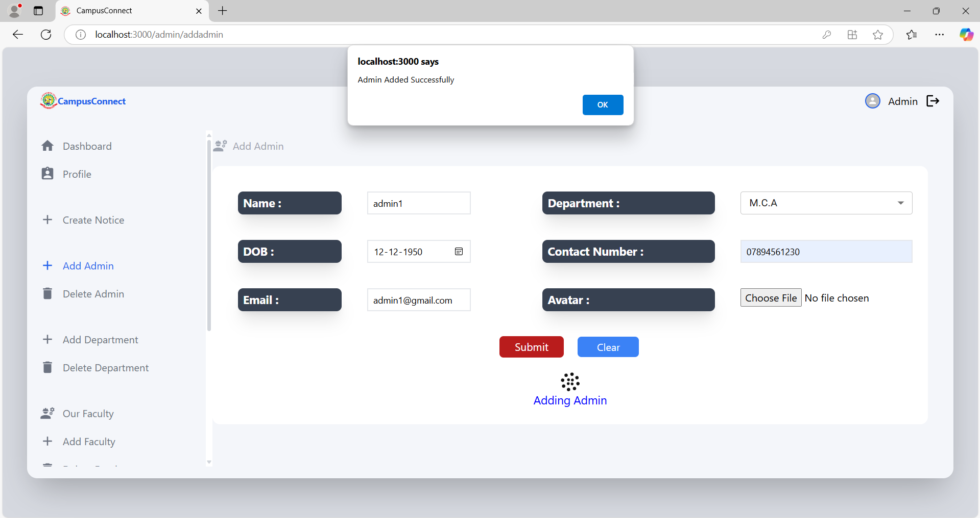
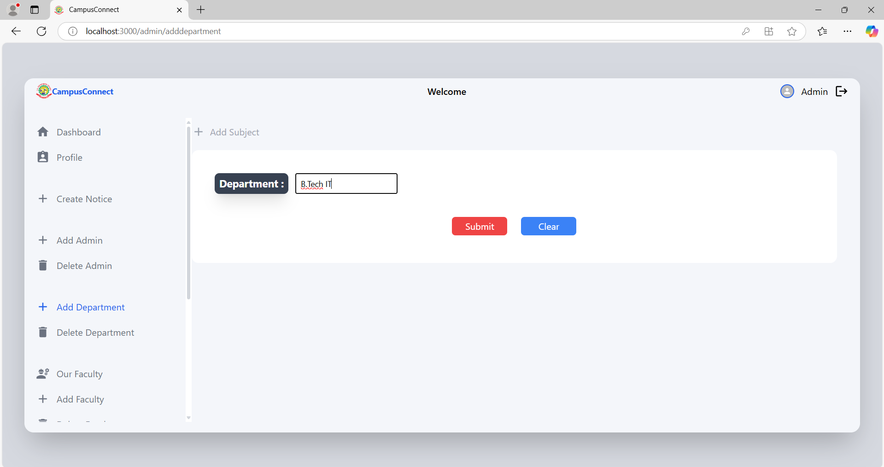
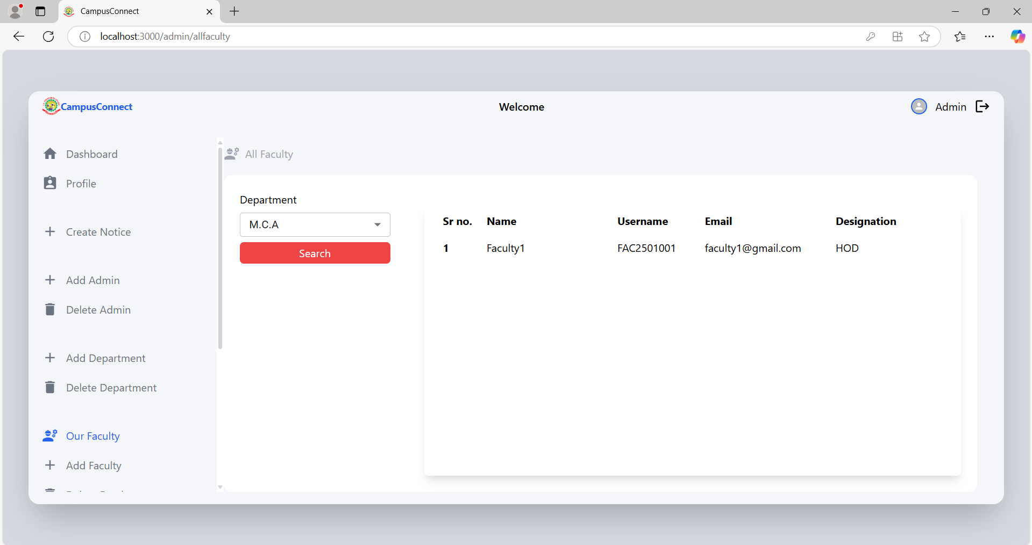
Sample screens

Slide 27
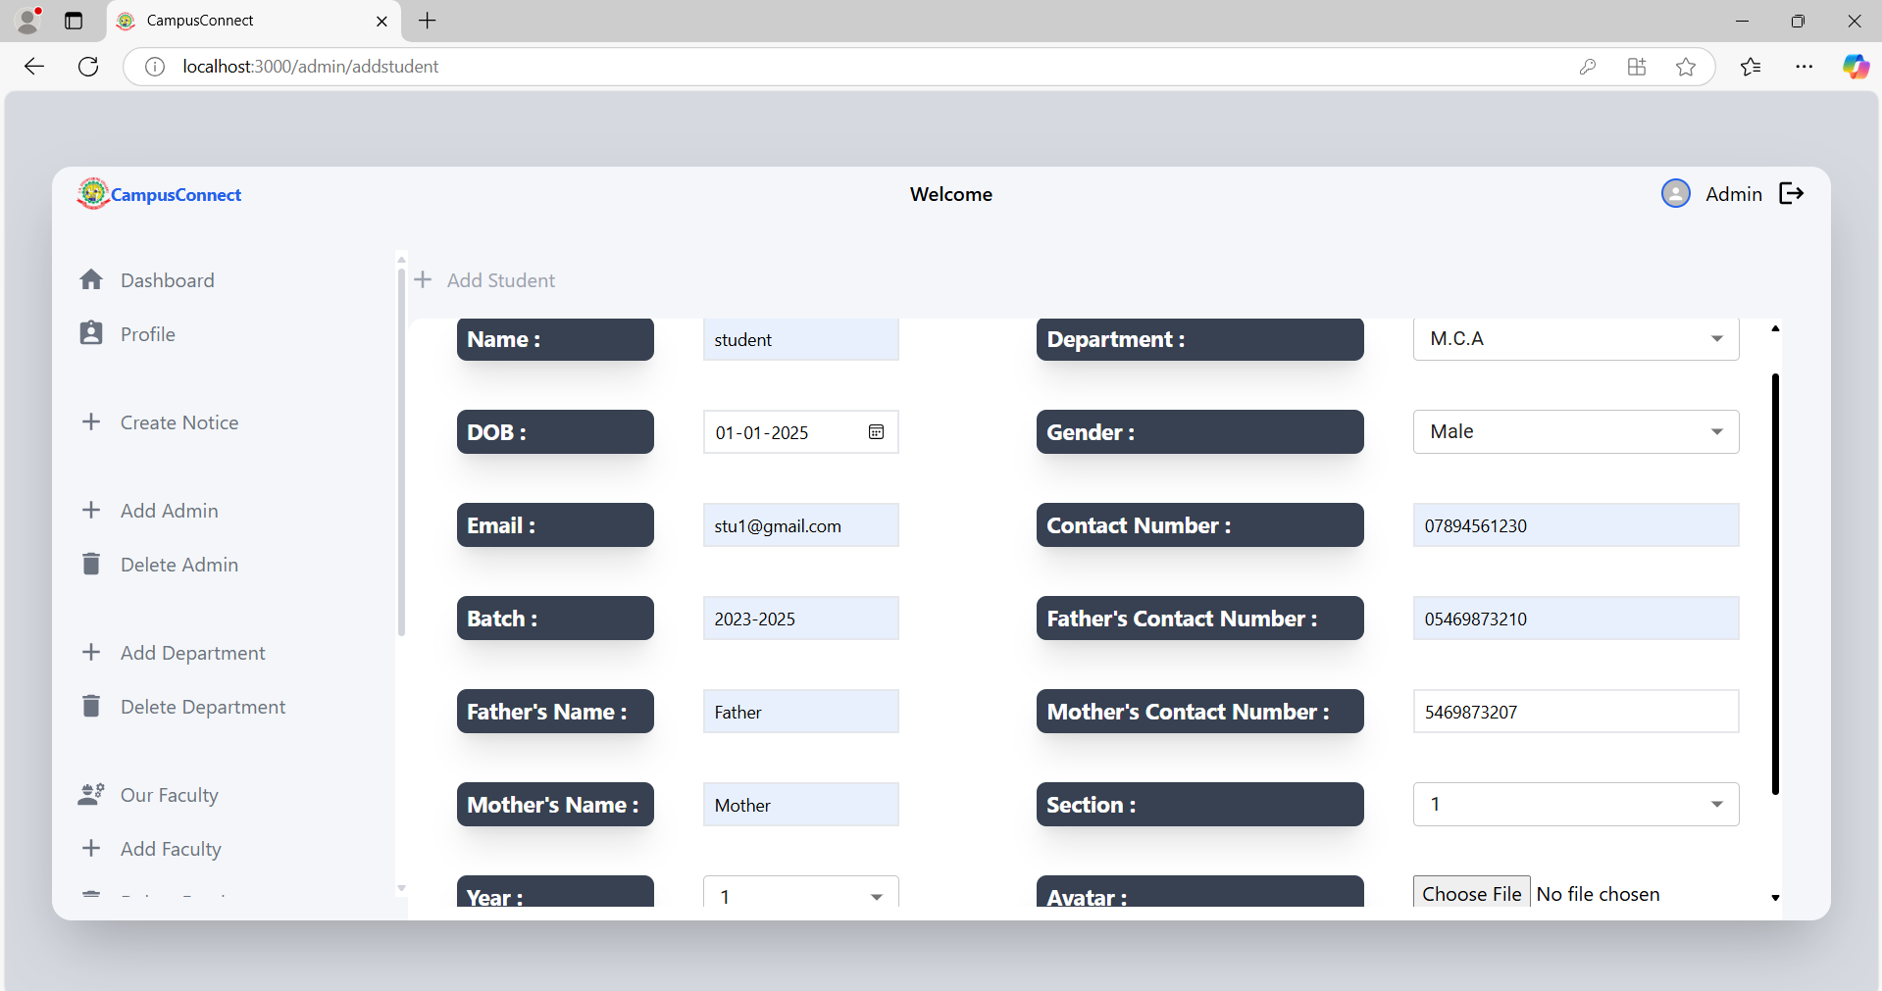
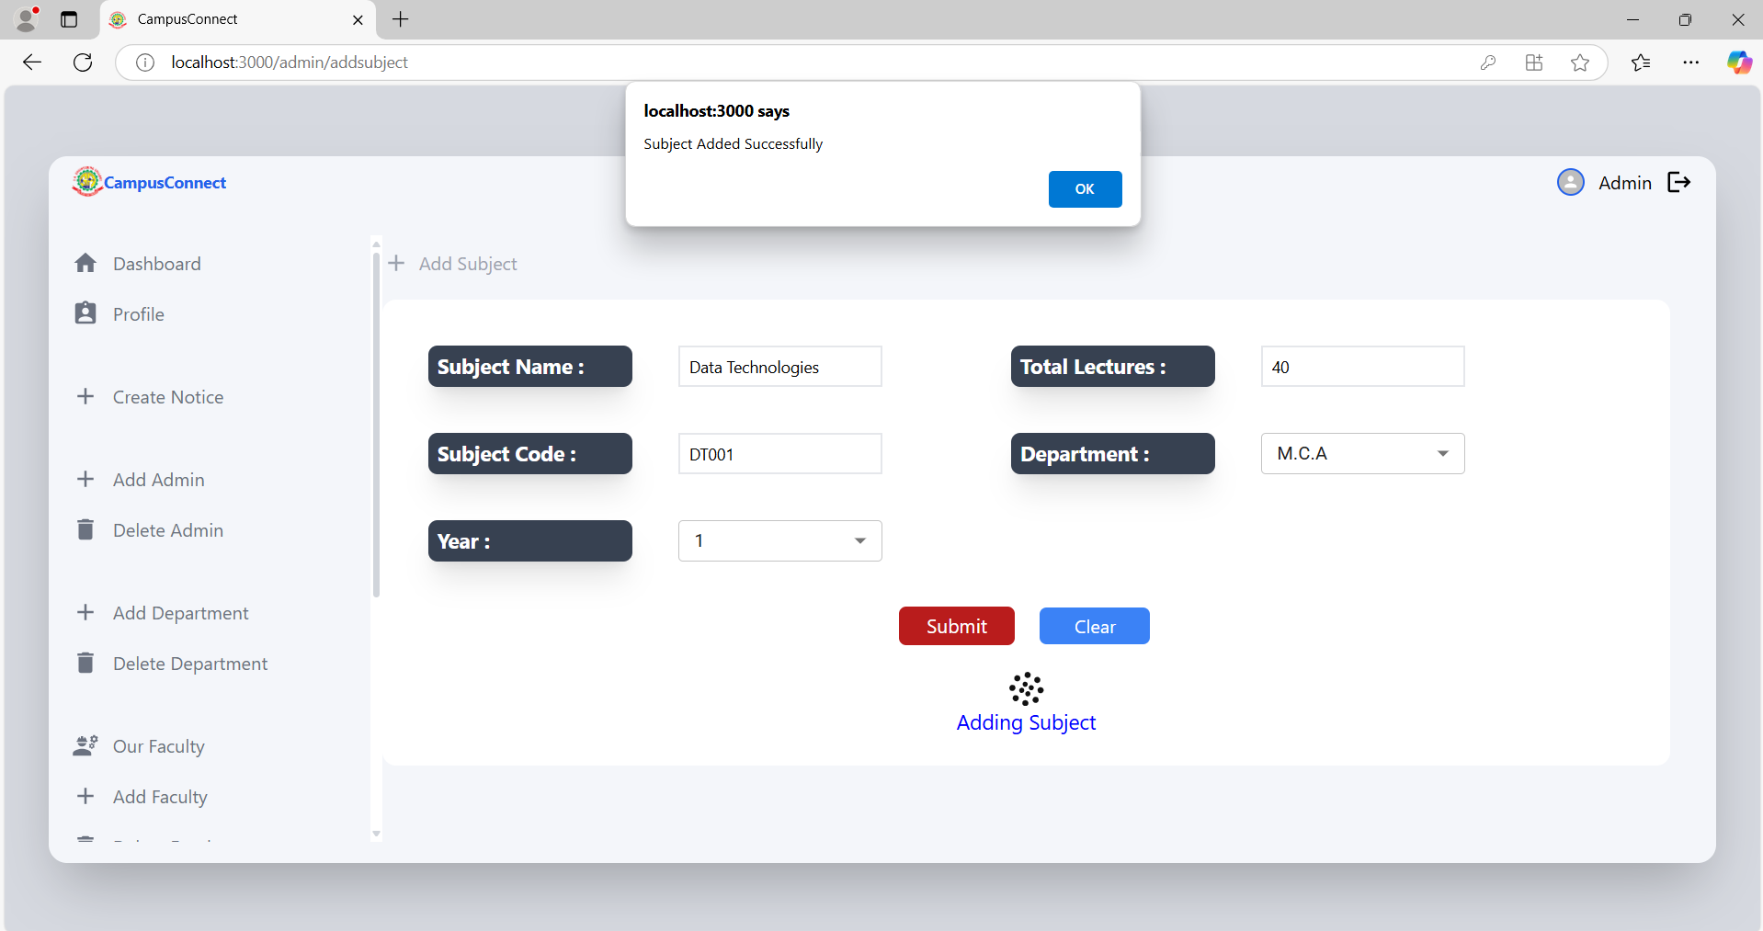
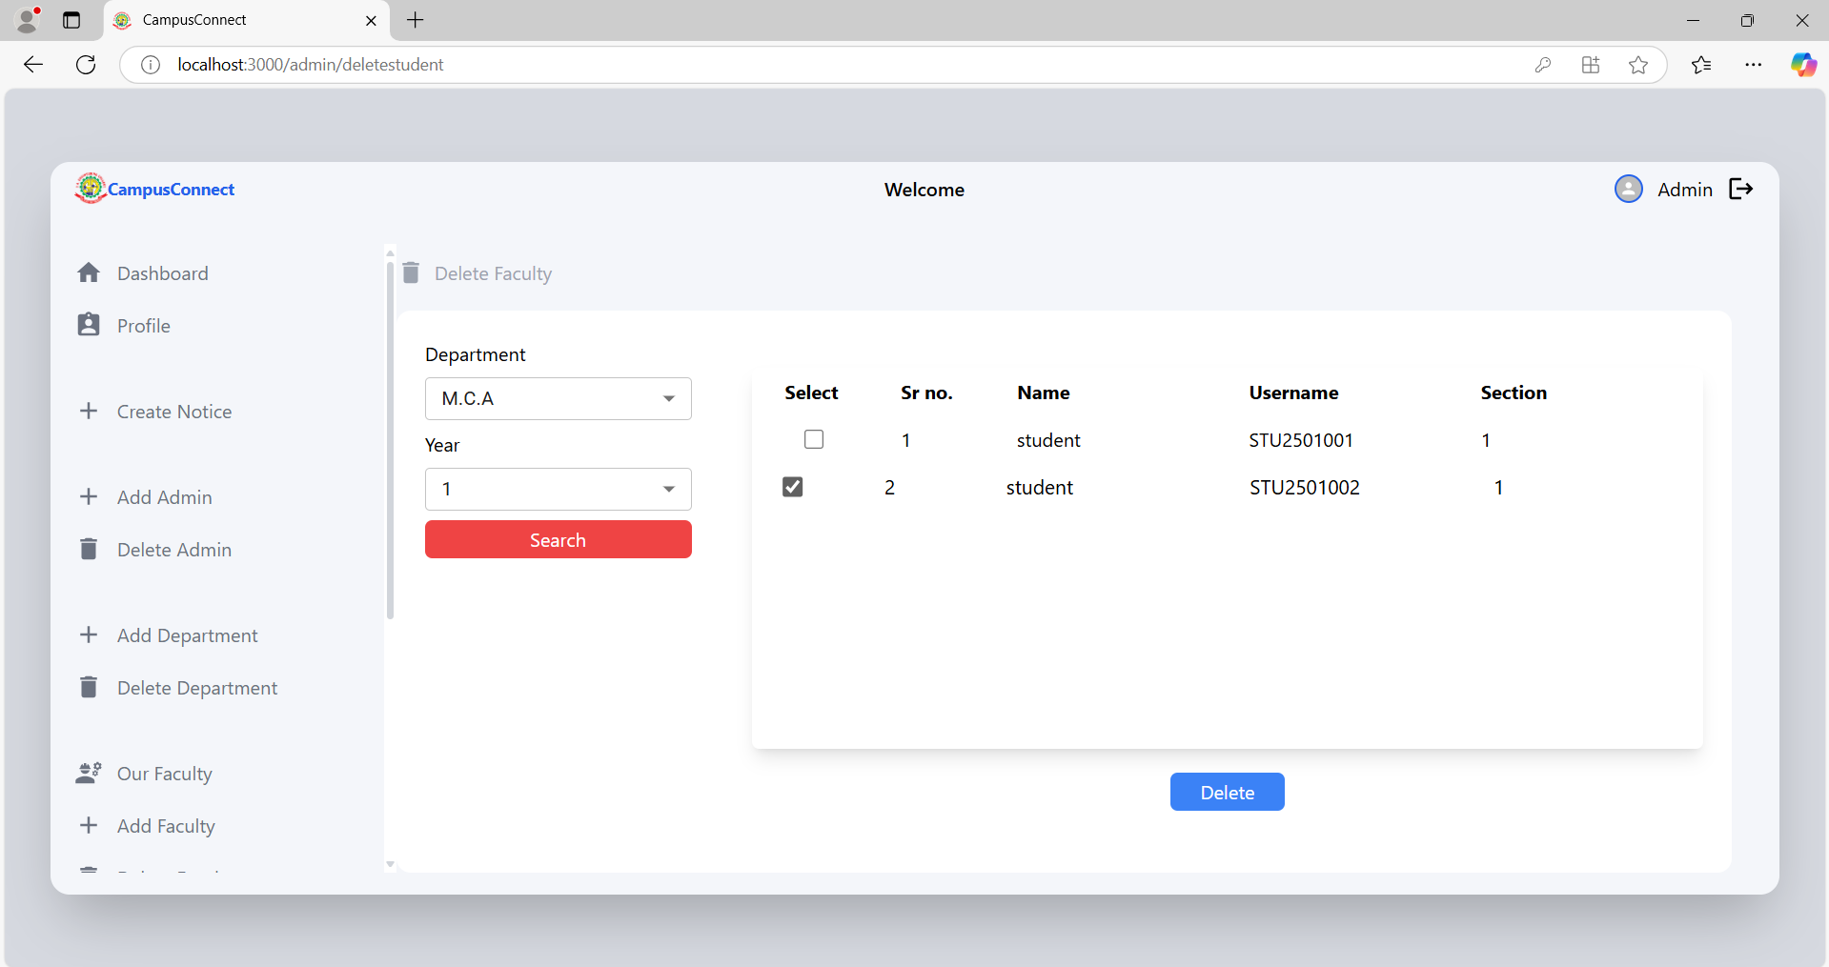
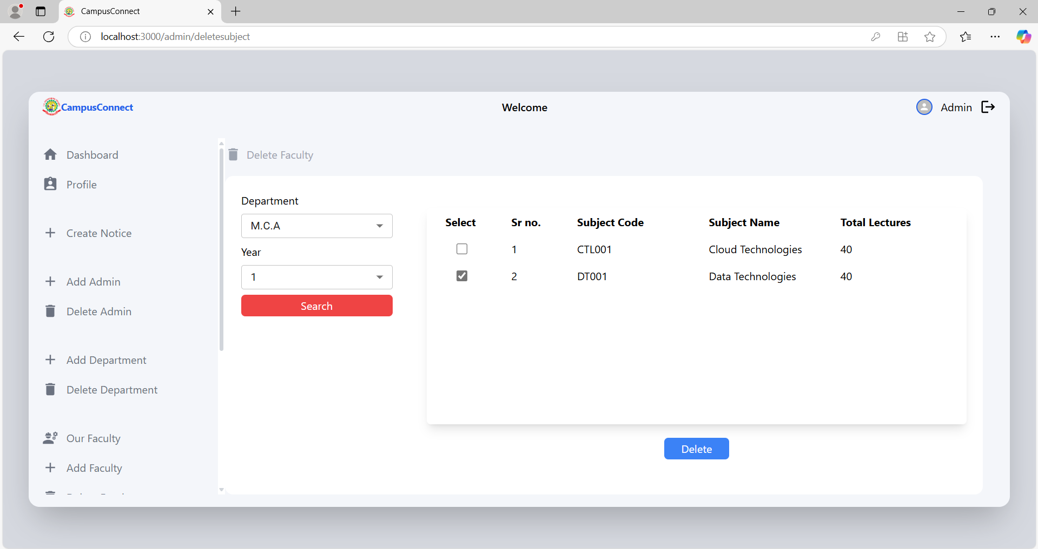
Sample screens

Slide 28
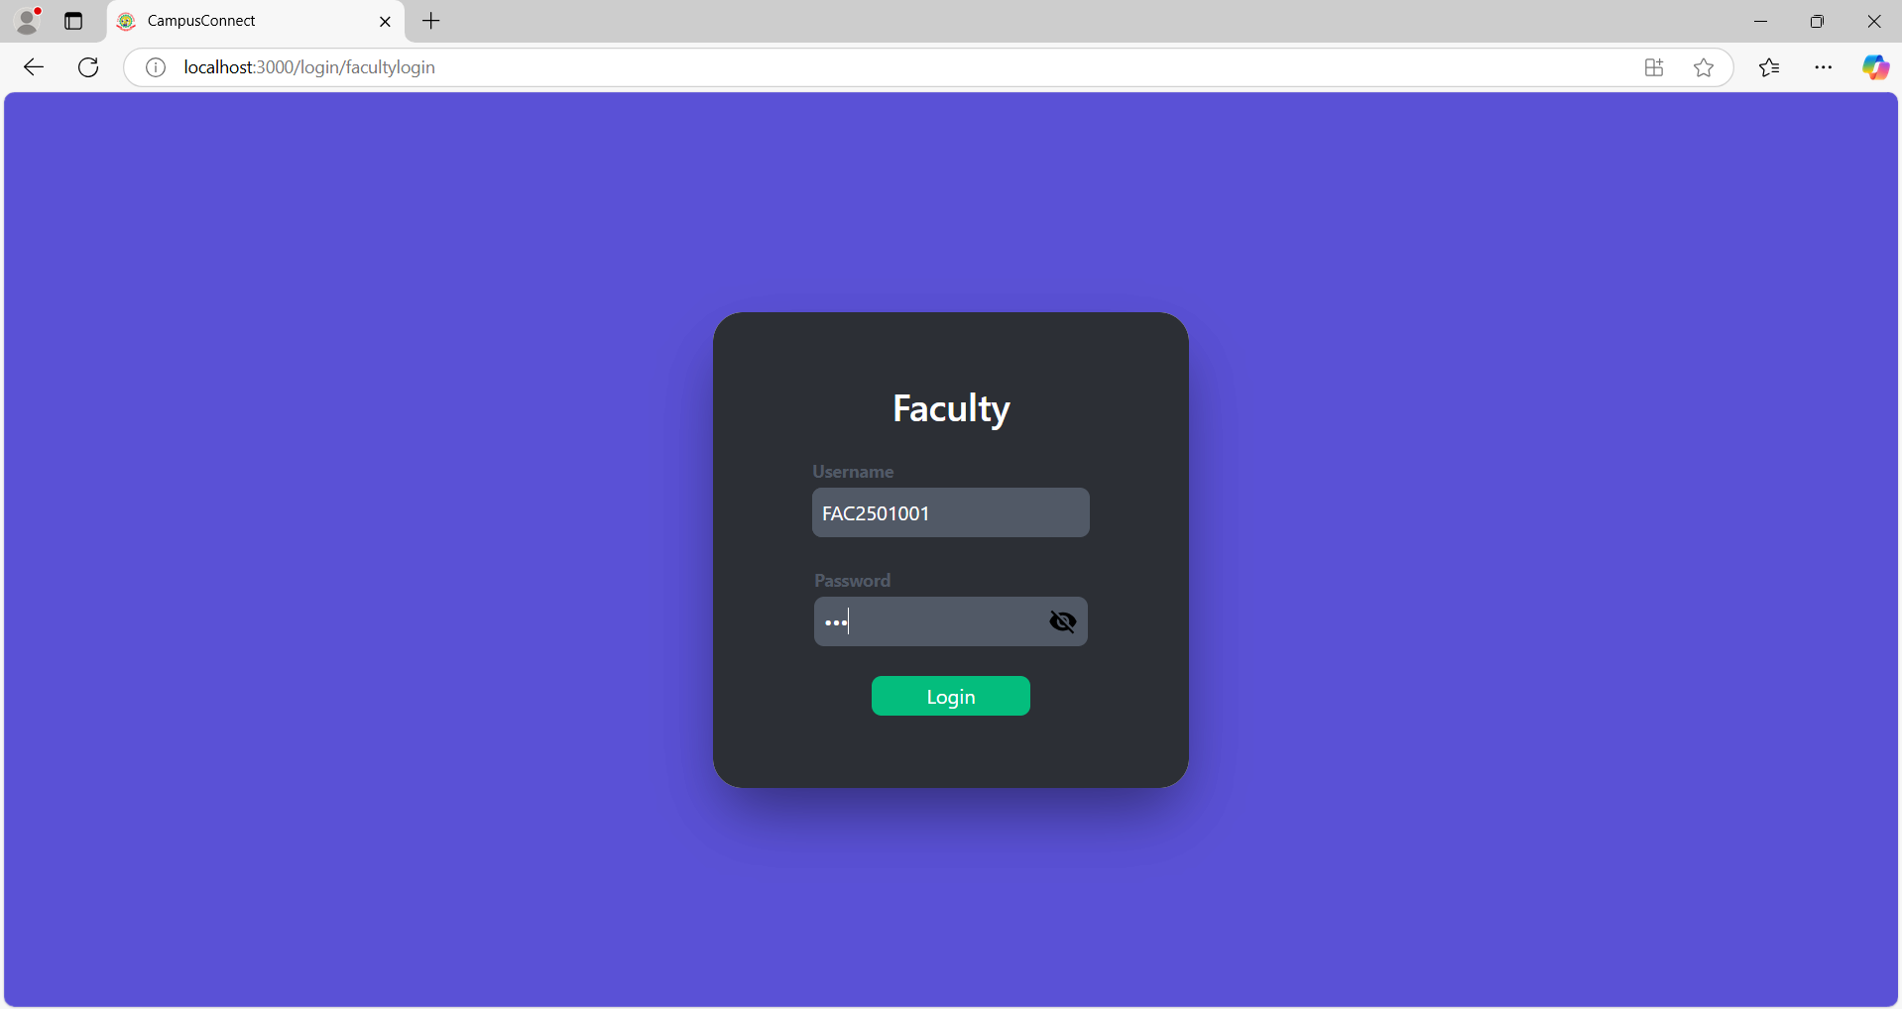
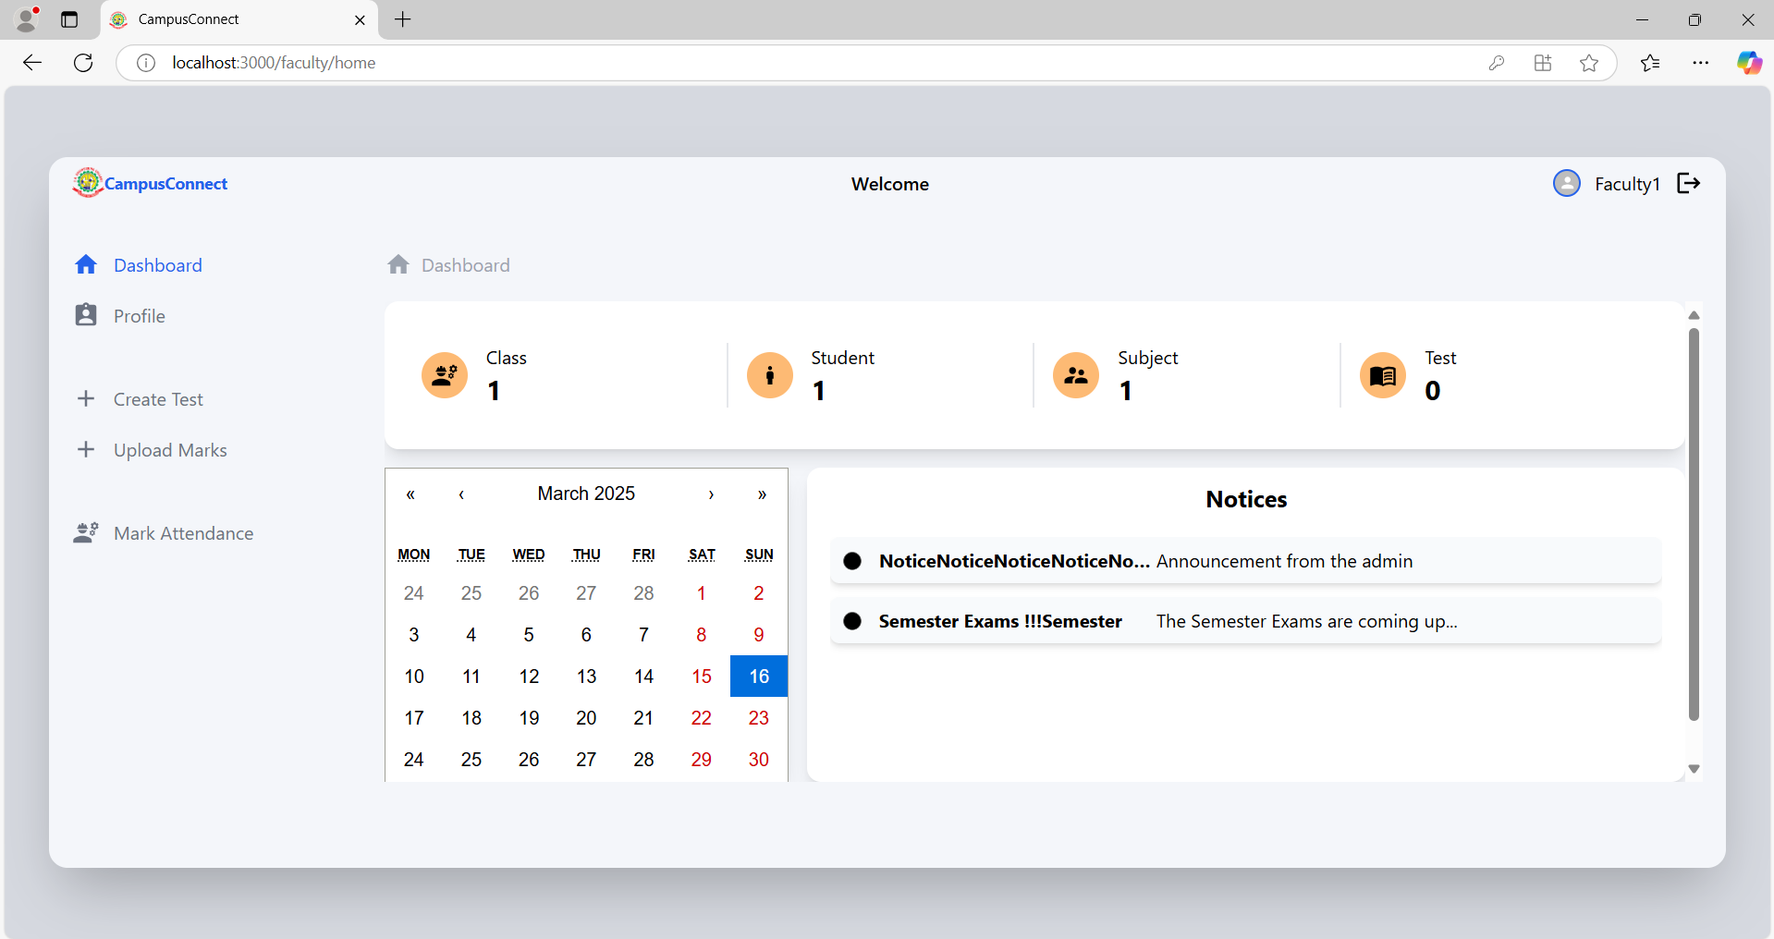
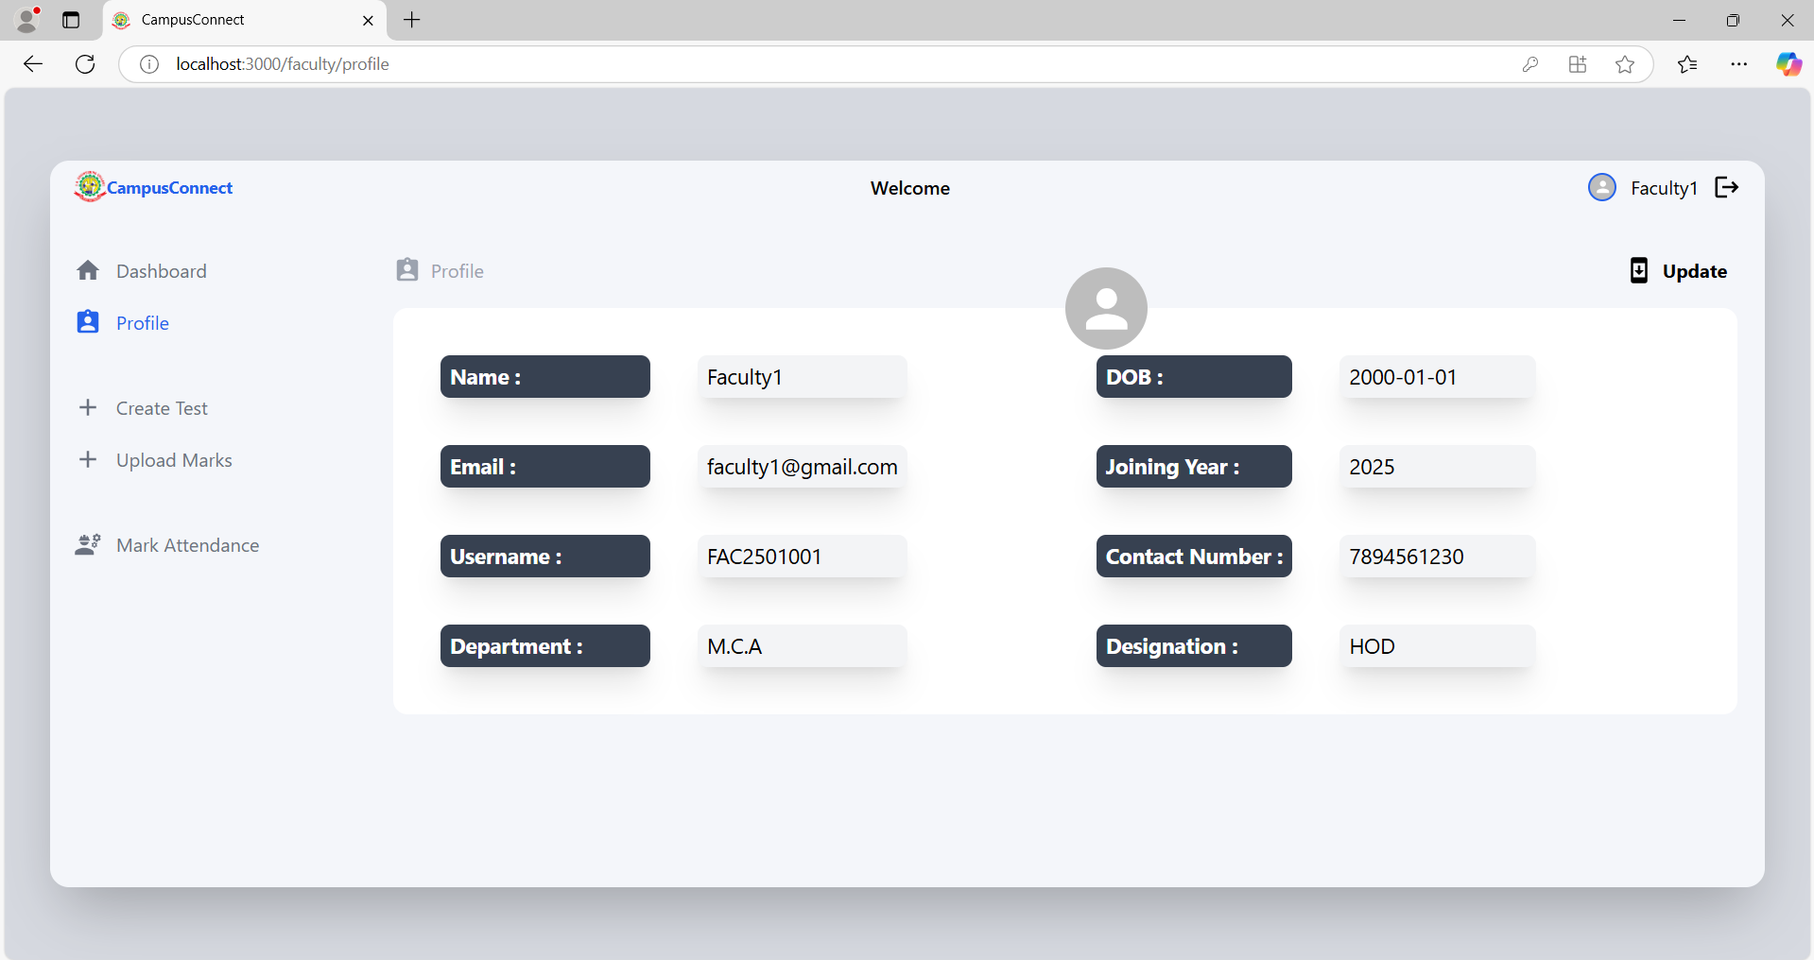
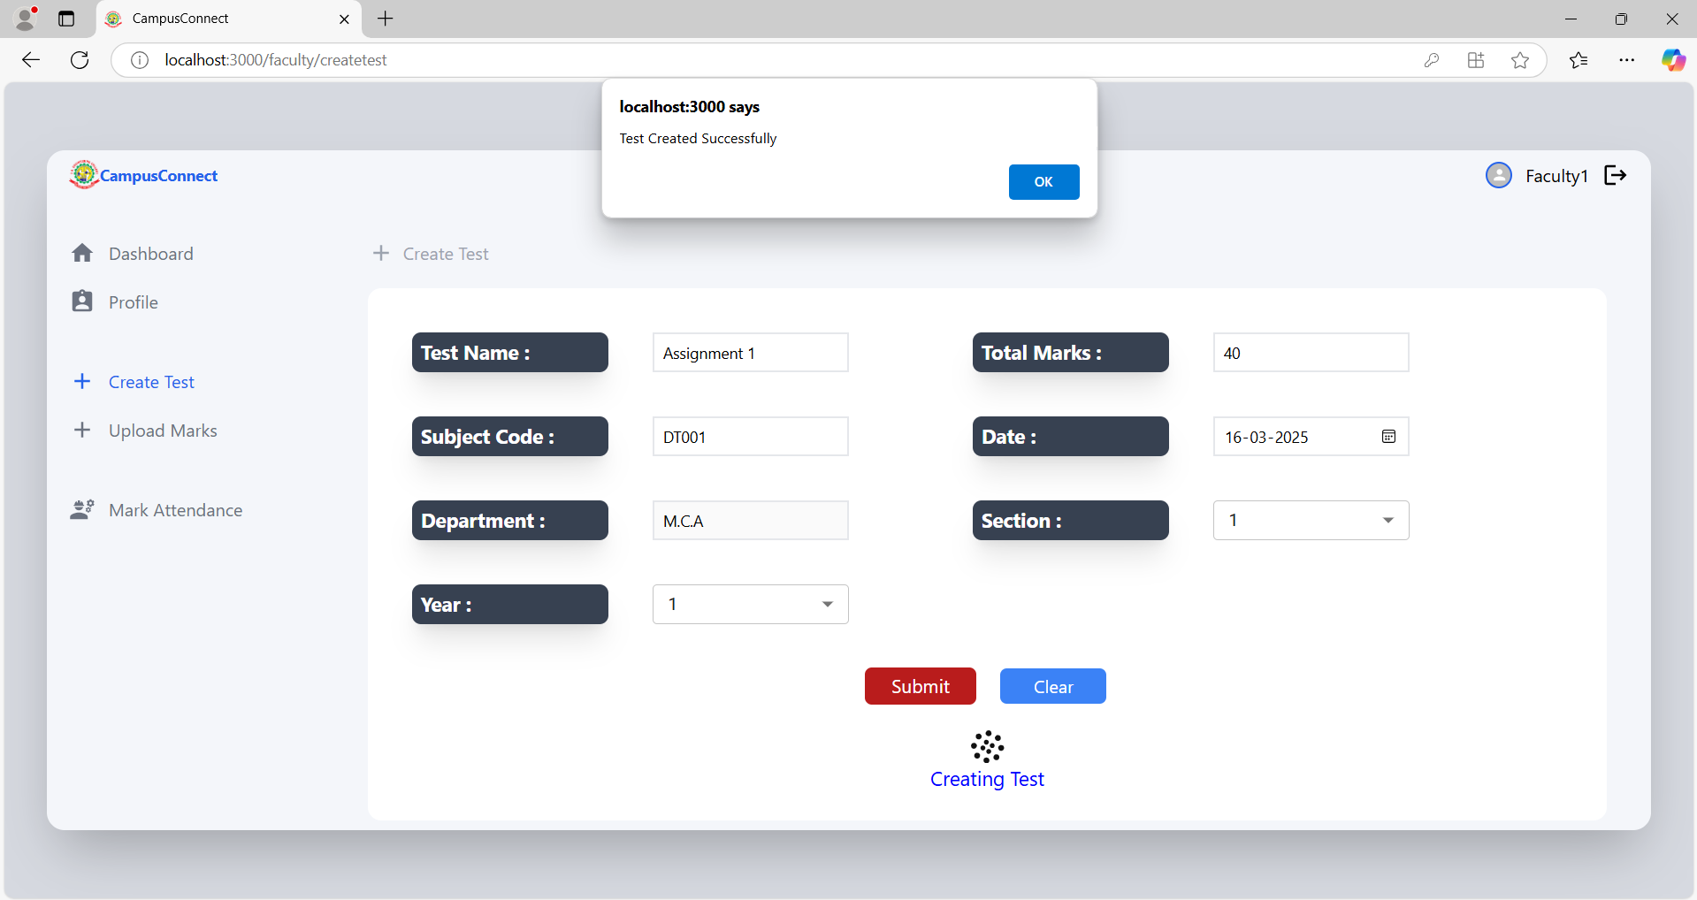
Sample screens

Slide 29
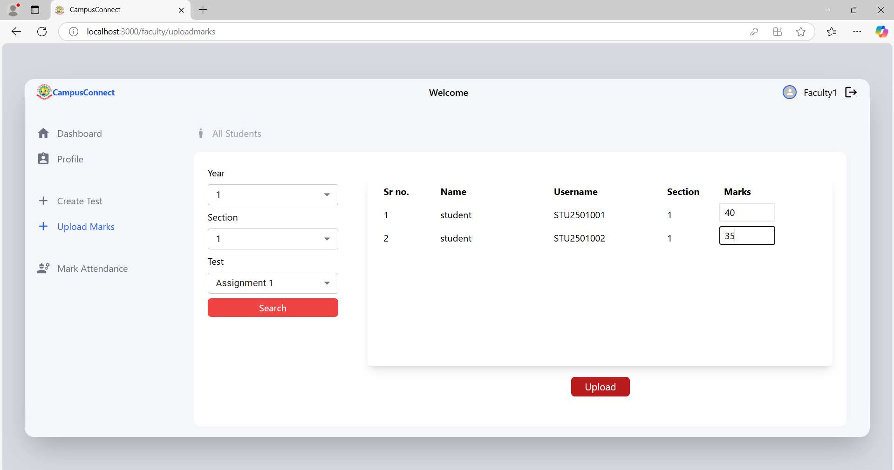
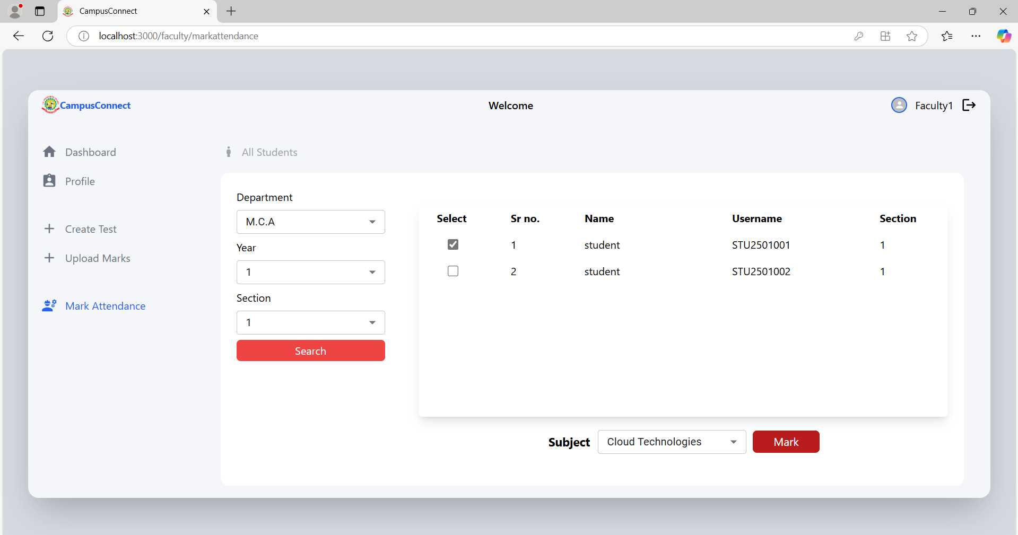
Sample screens

Slide 30
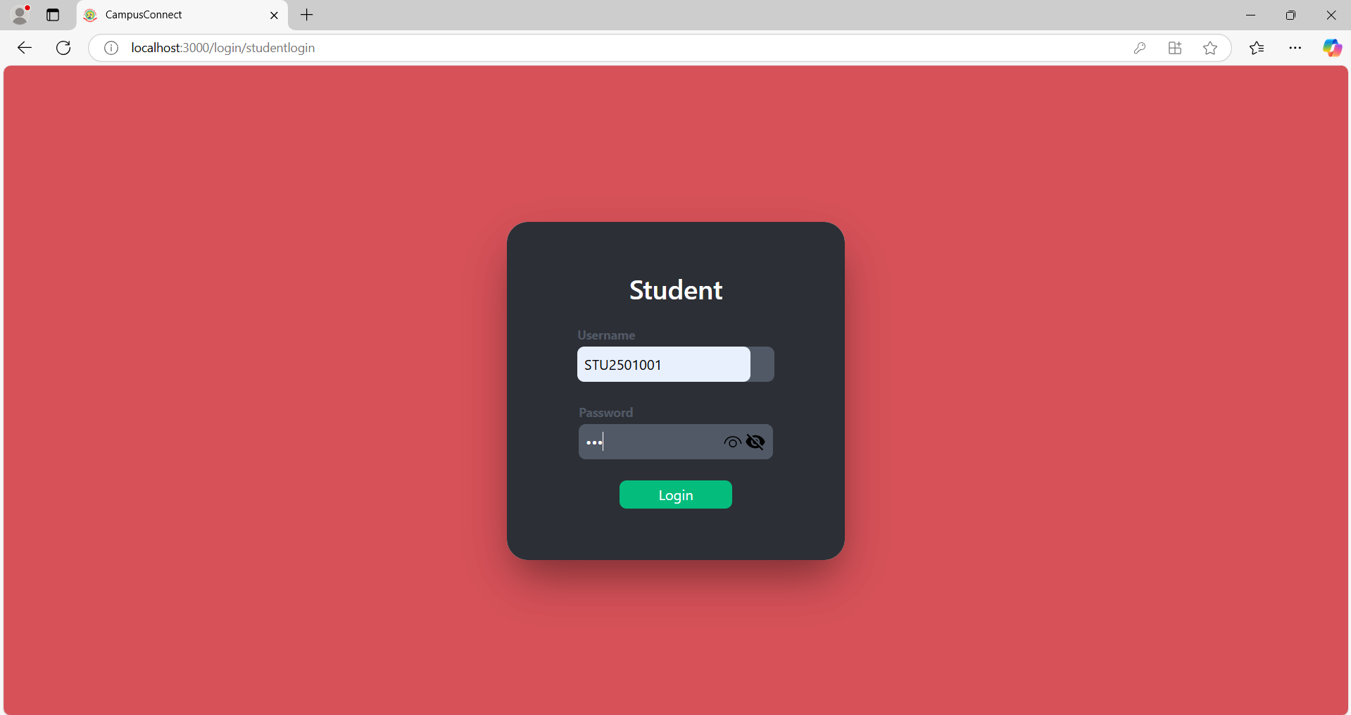
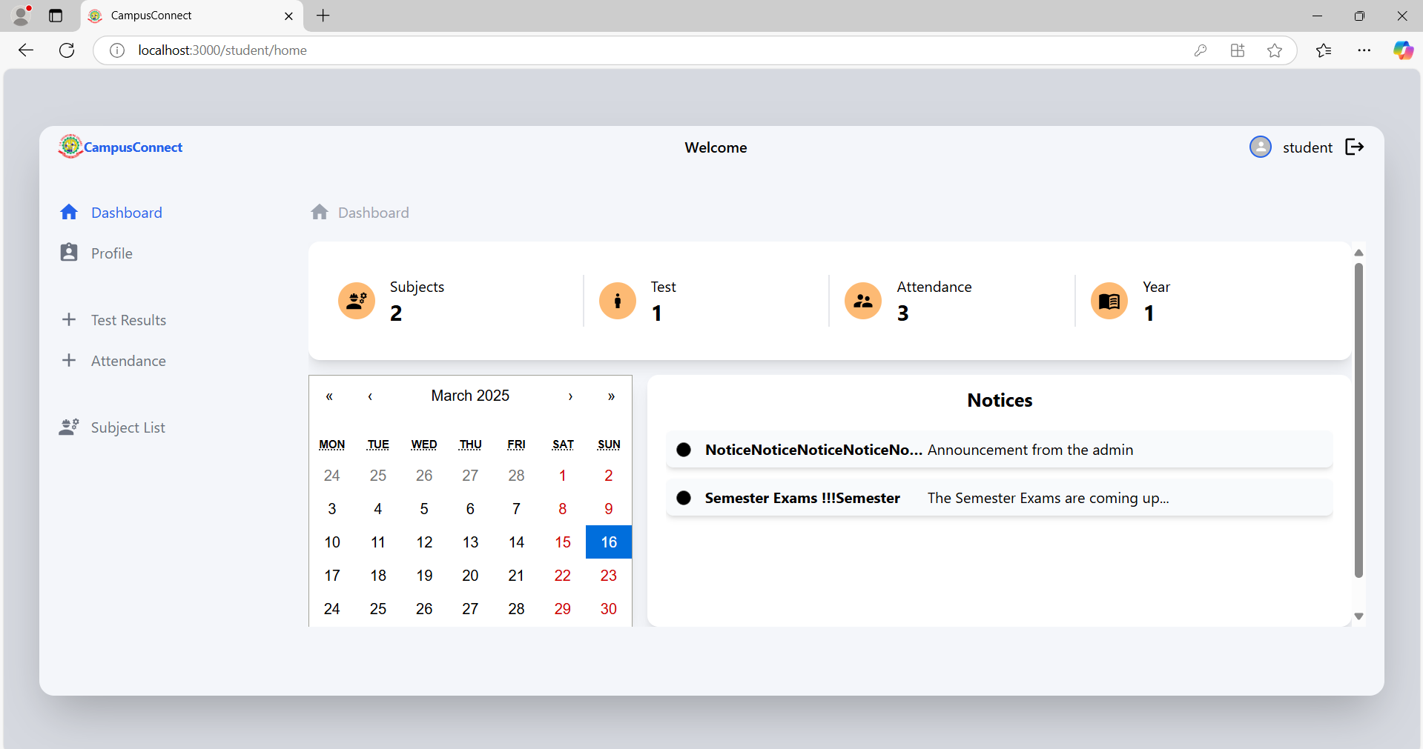
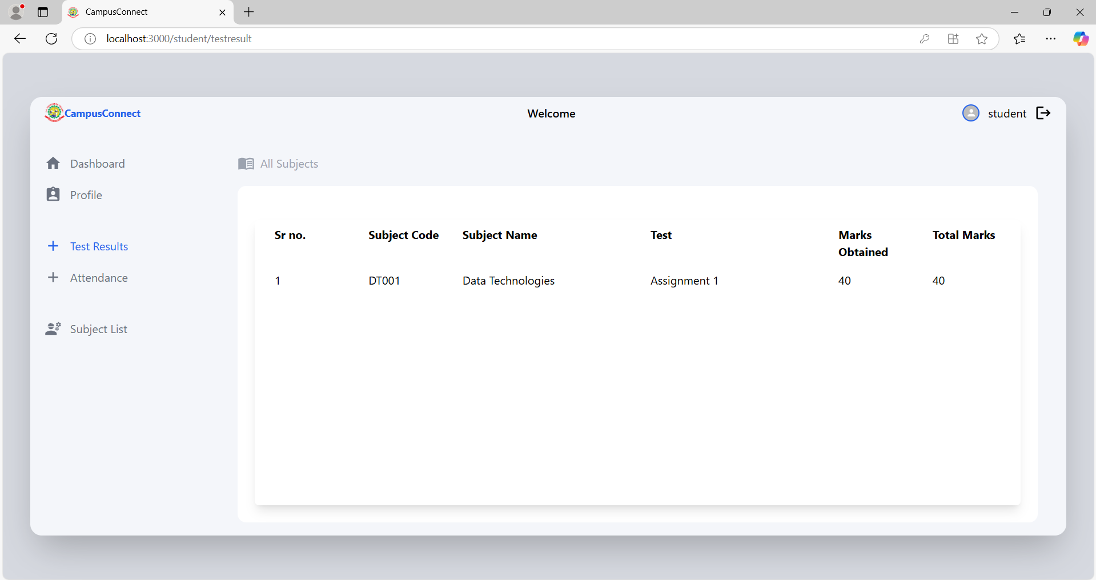
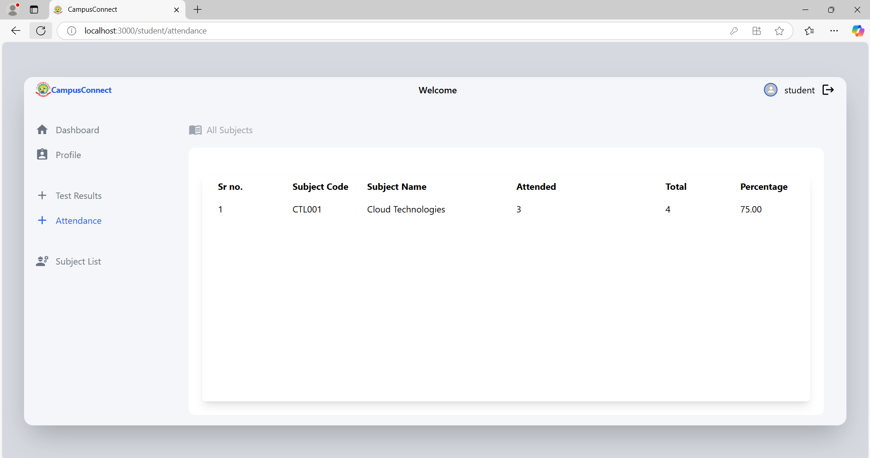
Sample screens

Slide 31
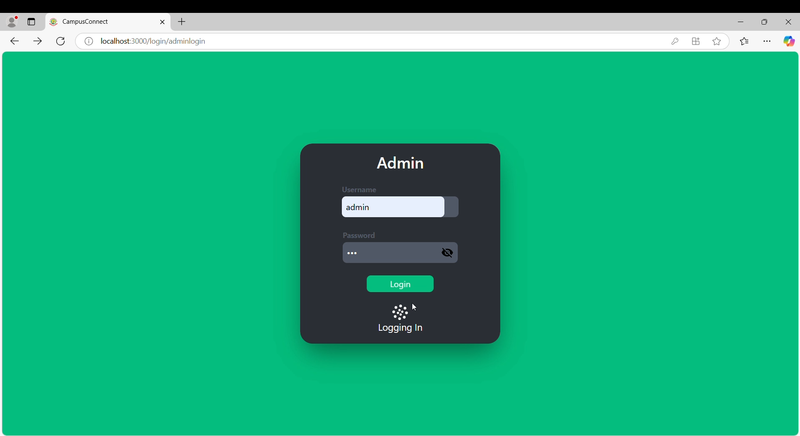
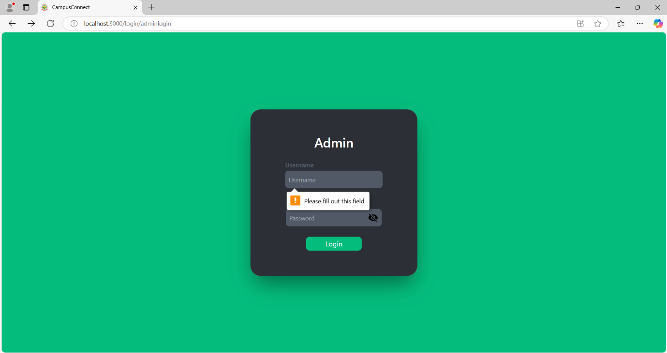
Testing : Unit testing
Test ID | LOGIN_001
Test Description | Verify that the login page renders correctly.
Expected Result | The login page should load successfully, displaying all required elements.
Actual Result | Pass
Test ID | LOGIN_002
Test Description | Verify that the system prevents login with empty fields.
Expected Result | The system should show validation errors for both fields.
Actual Result | Pass

Slide 32
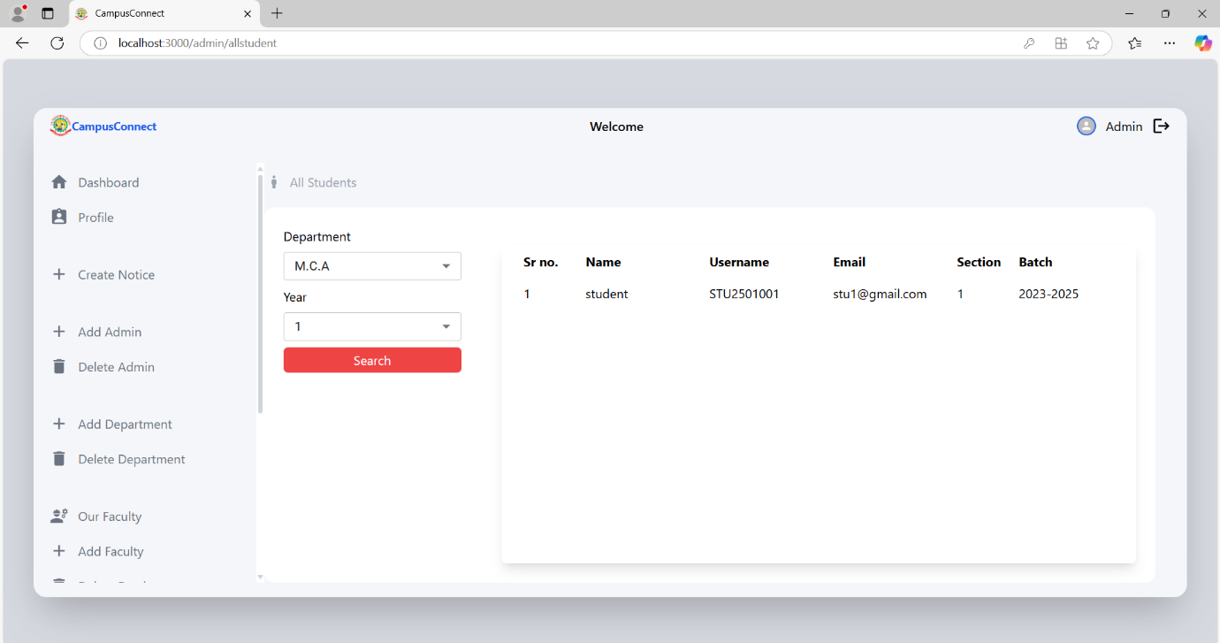
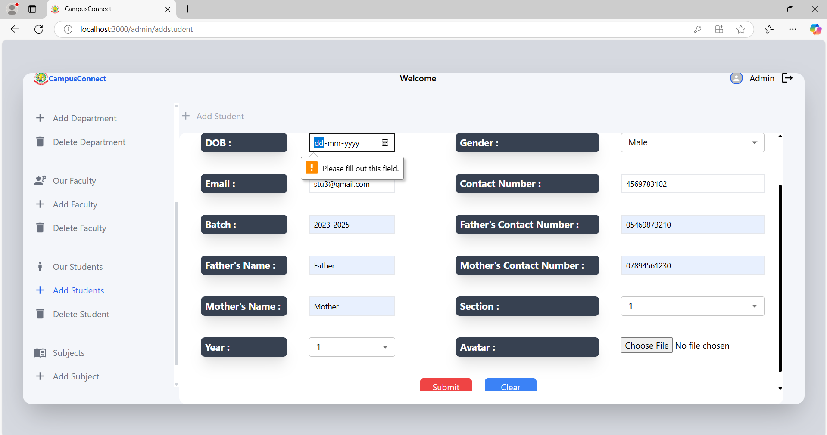
Testing : integration testing
Test ID | ADD_STUDENT_001
Test Description | Verify that a student is successfully added when valid details are provided.
Expected Result | The student is successfully stored in the database and displayed in the student list.
Actual Result | Pass
Test ID | ADD_STUDENT_002
Test Description | Ensure that the system prevents adding a student with missing required fields.
Expected Result | The system should display an error message like "All fields are required."
Actual Result | Pass

Slide 33
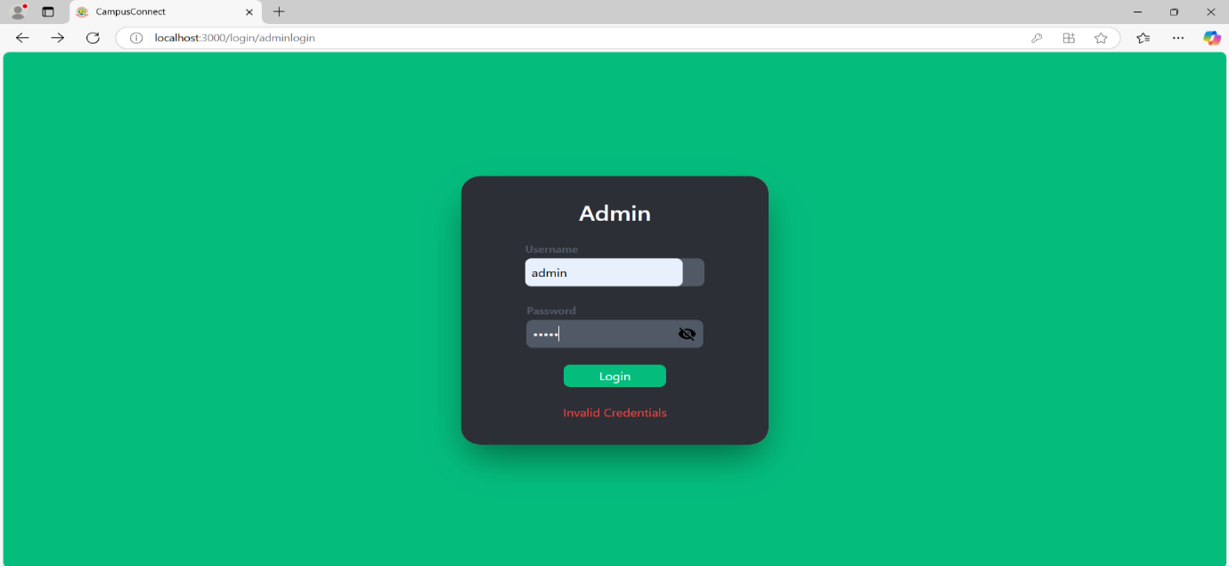
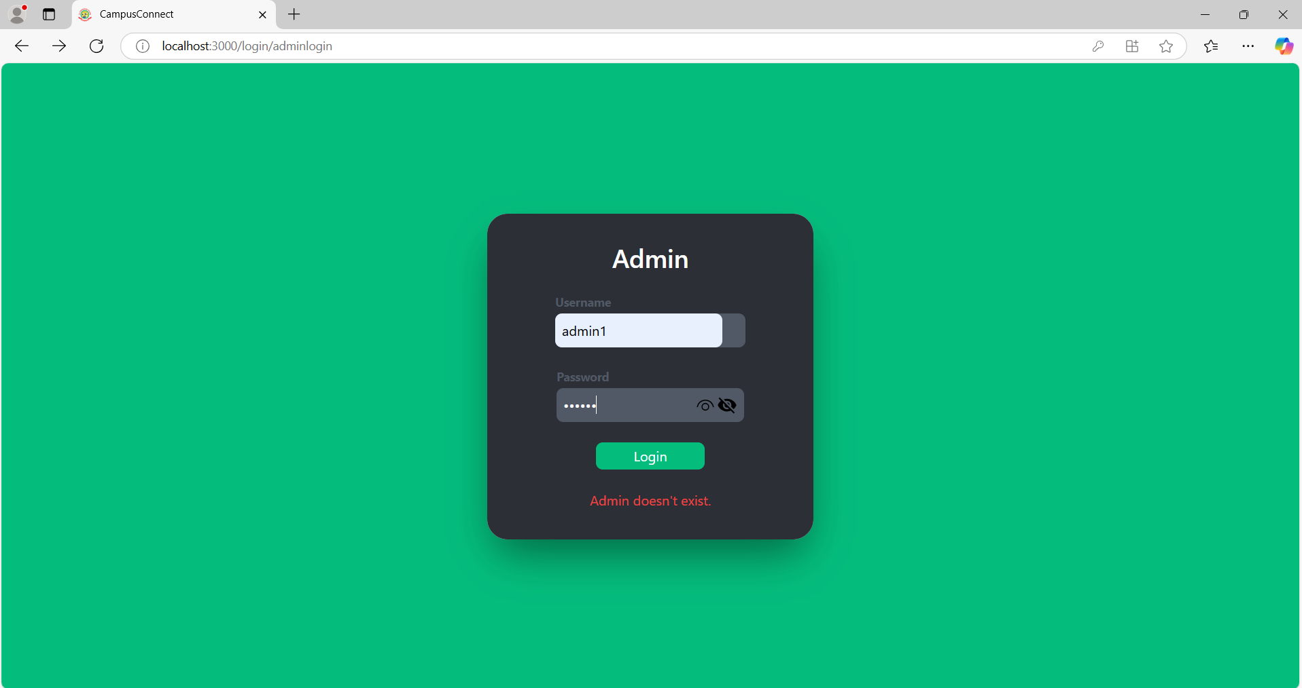
Testing : validation testing
Test Case 2: Login with Incorrect Password | LOGIN_002 | Check login behavior when the user enters the correct email but incorrect password. | The system should display an error message "Incorrect password." | Pass
Test Case 3: Login with Unregistered Username | LOGIN_003 | Validate that an unregistered username cannot be used to log in. | The system should display an error message "User not exists." | Pass

Slide 34
MERITS OF THE SYSTEM
The CampusConnect system offers several advantages, enhancing efficiency, automation, and communication within educational institutions:
Automated Student Management
Role-Based Access Control
User-Friendly Interface
Secure Authentication System
Real-Time Data Access
Efficient Performance
Error Handling & Validation
Centralized Database Management
Scalability

Slide 35
LIMITATIONS OF THE SYSTEM
Limited Offline Access
No Live Notifications
Limited Mobile Optimization
No Automated Attendance via Biometrics

Slide 36
FUTURE ENHANCEMENTS
To improve CampusConnect, several enhancements are planned for future updates:
Developing a mobile-friendly version or app for better accessibility.
Integrating real-time notifications for important updates like attendance, exam schedules, and notices.
Implementing AI-driven analytics to provide insights into student performance and attendance trends.
Enhancing attendance tracking by integrating biometric scanners or RFID-based attendance marking.
Connecting with LMS platforms like Moodle, Google Classroom, or Blackboard for a seamless learning experience.

Slide 37
CONCLUSION
Efficient & Automated Management CampusConnect streamlines academic and administrative tasks like attendance, enrollment, grading, and reporting, reducing manual work and boosting accuracy.
Secure Role-Based Access Provides tailored access for Admins, Faculty, and Students with JWT authentication, ensuring data privacy and controlled interactions.
User-Friendly & Scalable System Features a modern UI, centralized data, and optimized performance—designed to adapt to institutions of any size.
Future-Ready Platform Planned upgrades include mobile app, real-time notifications, biometric attendance, and LMS integration for enhanced user experience.

Slide 38
Thank you
SURIYAPRATHAP . S
(111923MC02053)
MASTER OF COMPUTER APPLICATIONS
S. A. ENGINEERING COLLEGE

